Slide 1
Career Services Center
Presented by: Mat Genuser,
Career Services Coordinator

Slide 2
Goals of the presentation
Career Services Team
Our Location
Link between Career Services, CASE & Counseling
What We Offer
3 Step Prep
Community Resources & Partnerships

Slide 3
Meet our Staff
Mat Genuser: Career Services &
CWE Coordinator
Pam Allen: Part-Time Career Services & CWE Administrative Assistant

Slide 4
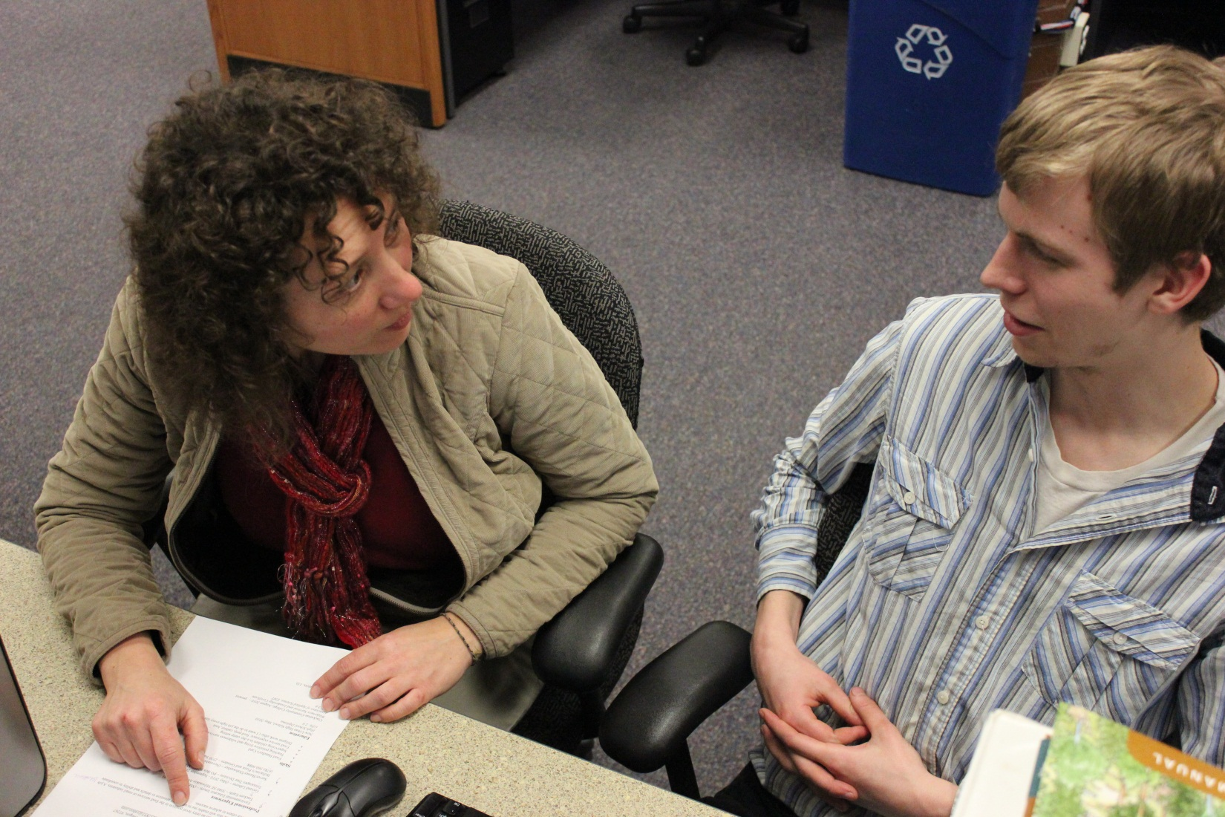
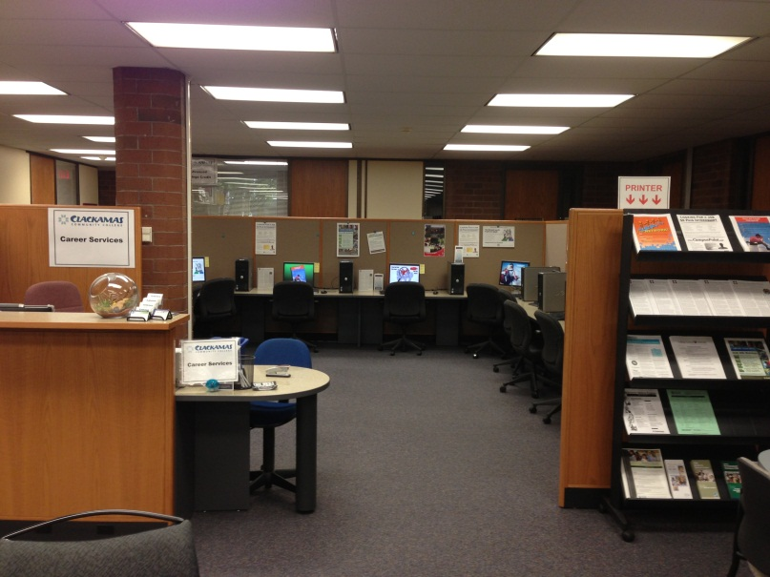
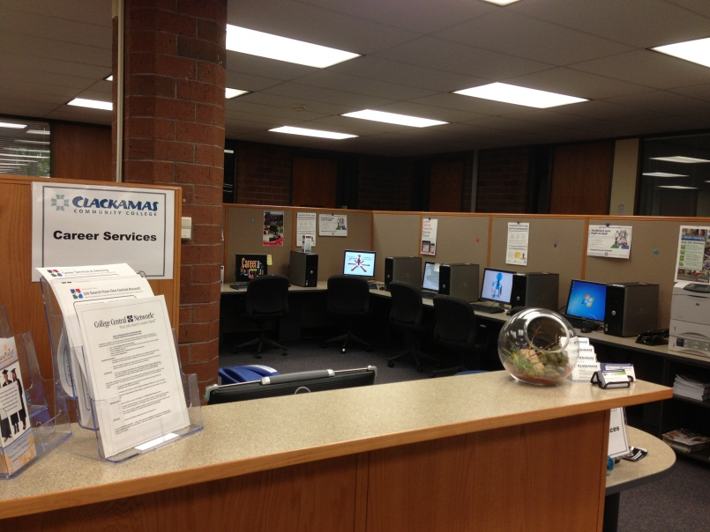
Career Services is located in the Community Center

Slide 5
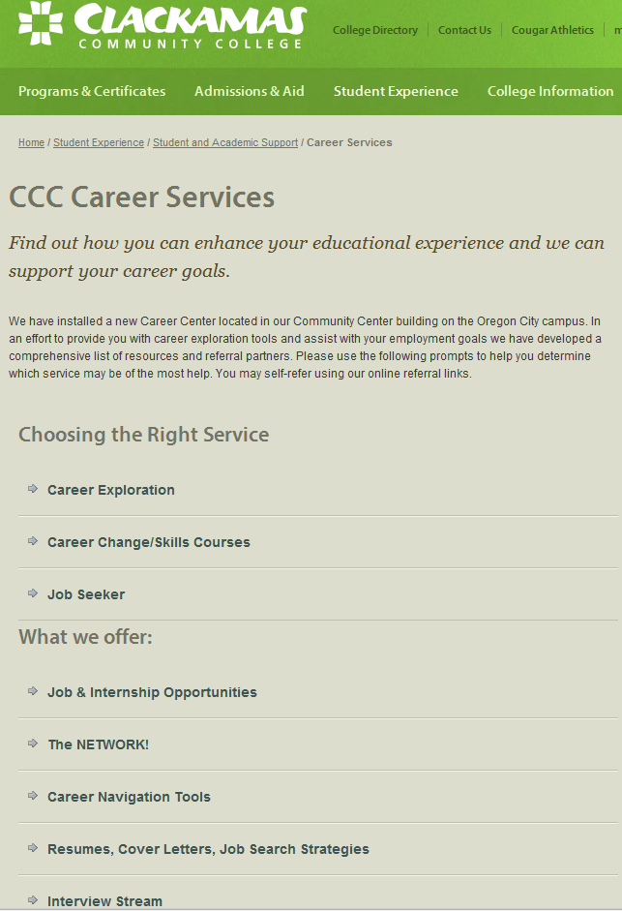
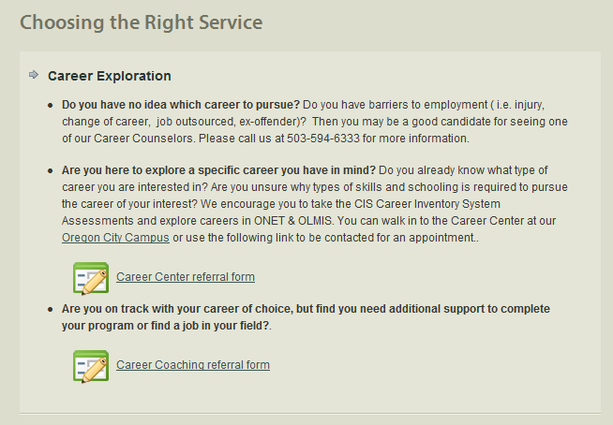
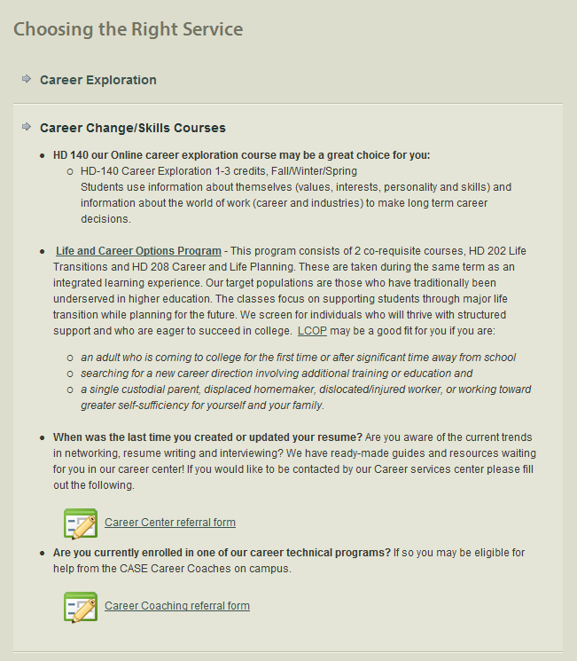
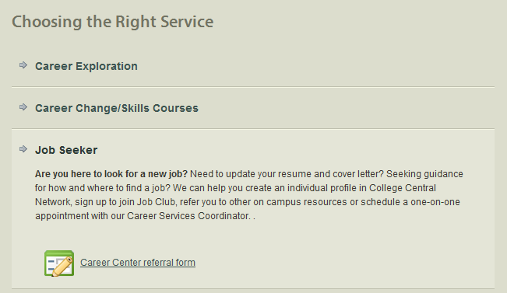
Career Services Website

Slide 6
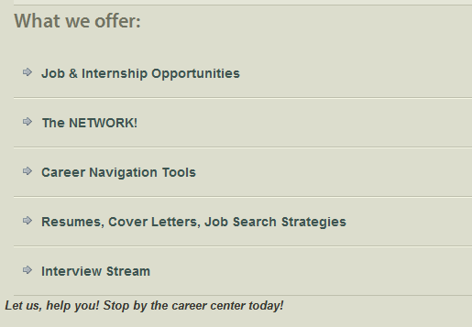
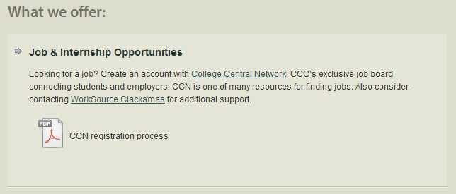
Career Services Offerings

Slide 7
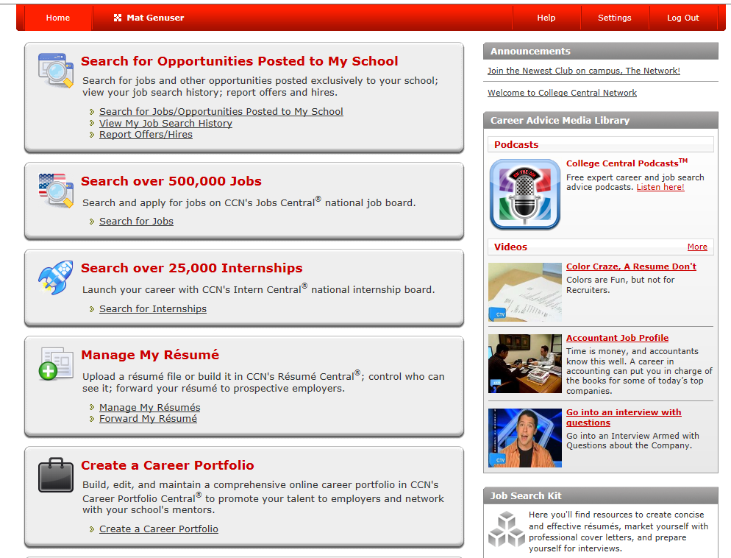
College Central Network (CCN)

Slide 8
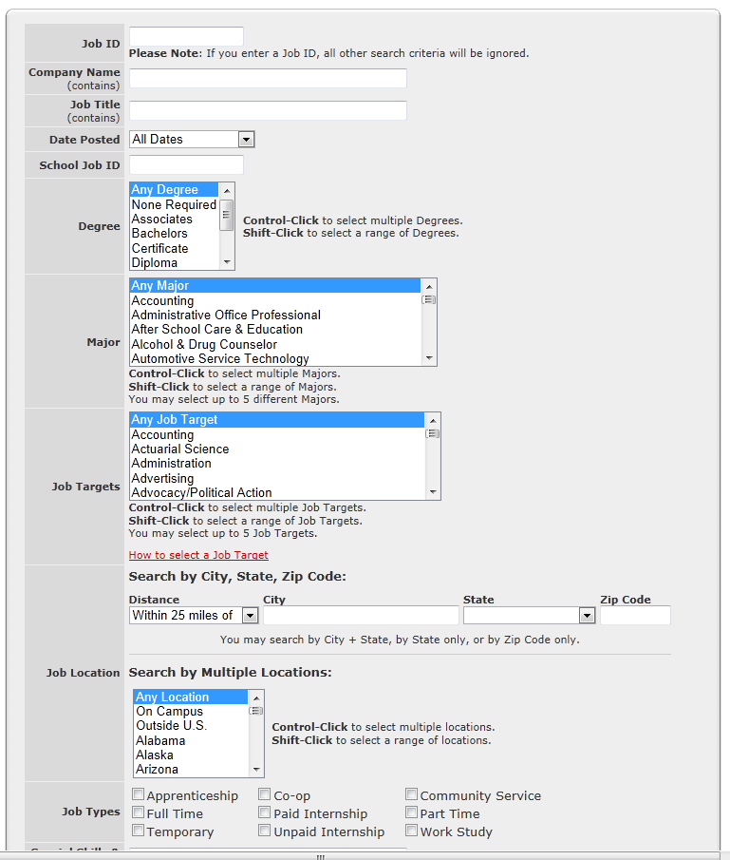
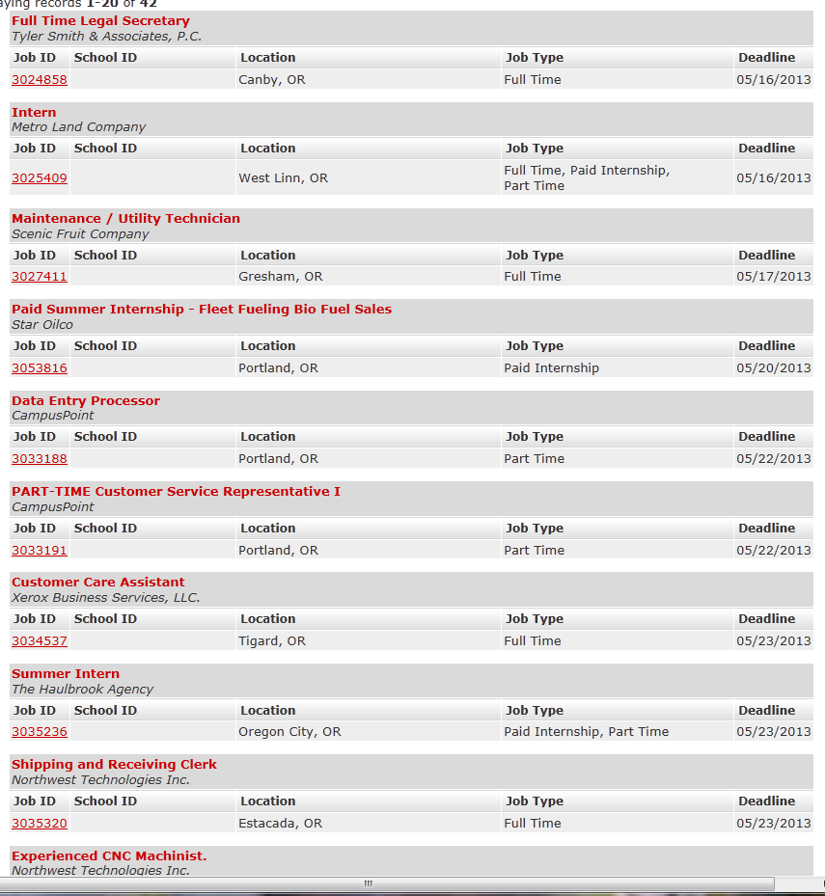
CCN-Local Employers Hiring CCC Students: Job Search Feature

Slide 9
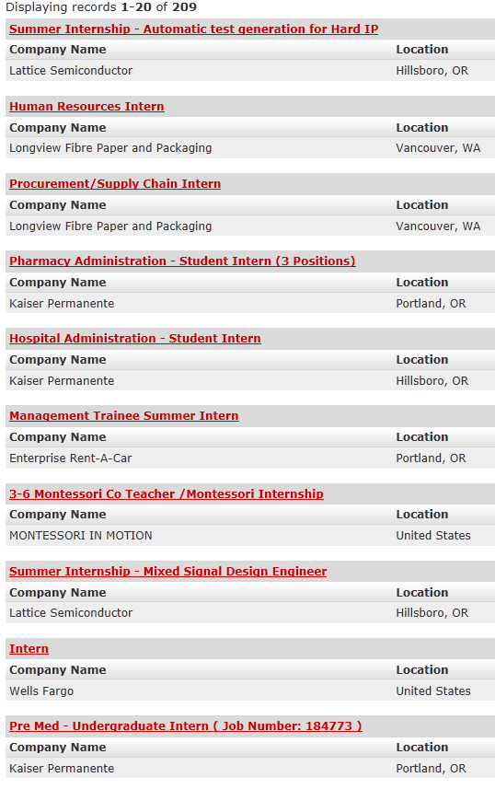
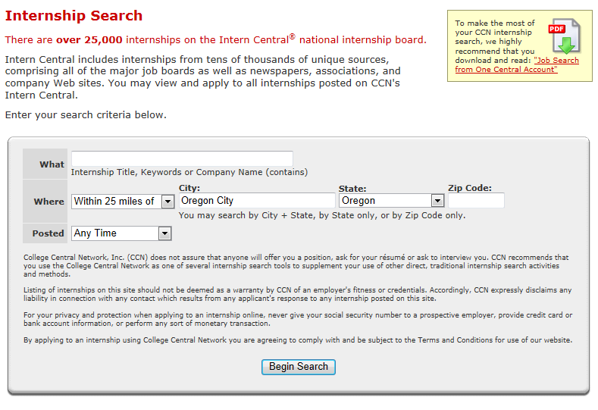
CCN Internship Search Feature

Slide 10
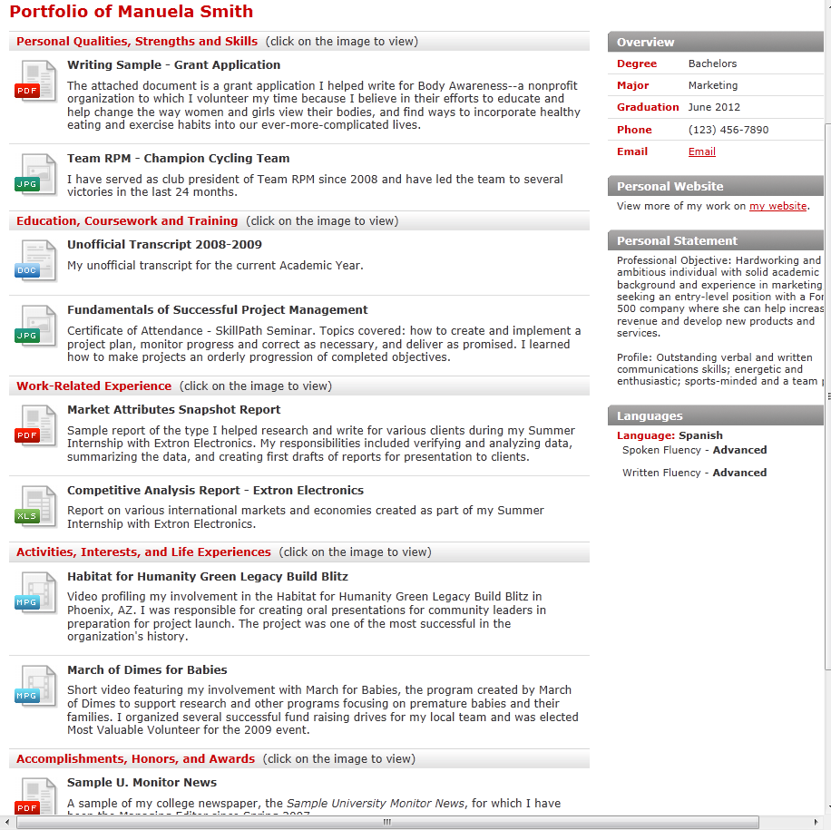
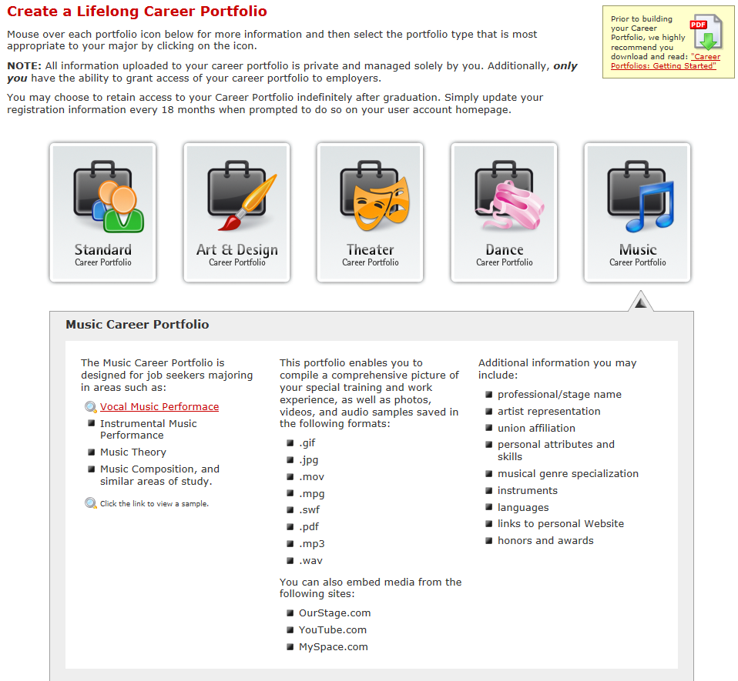
CCN-Create a Portfolio

Slide 11
Additional Features of CCN
Extensive Job Search Options
Change your status from Student to Alumni with one click
Employers can seek out our students
Tracking student data
Download career advice & information to your iPod
And much, much more!

Slide 12
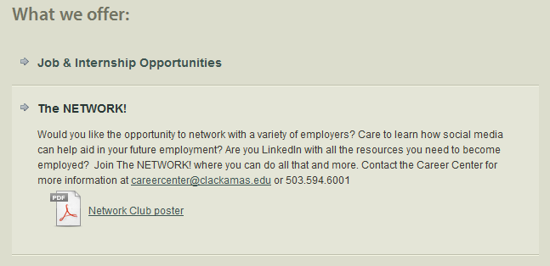
The NETWORK!

Slide 13
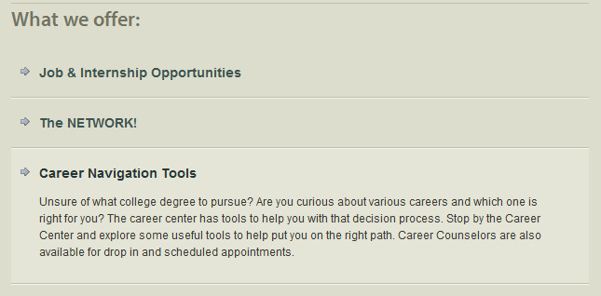
Career Navigation Tools

Slide 14
Oregon Career Information System (CIS)

Slide 15
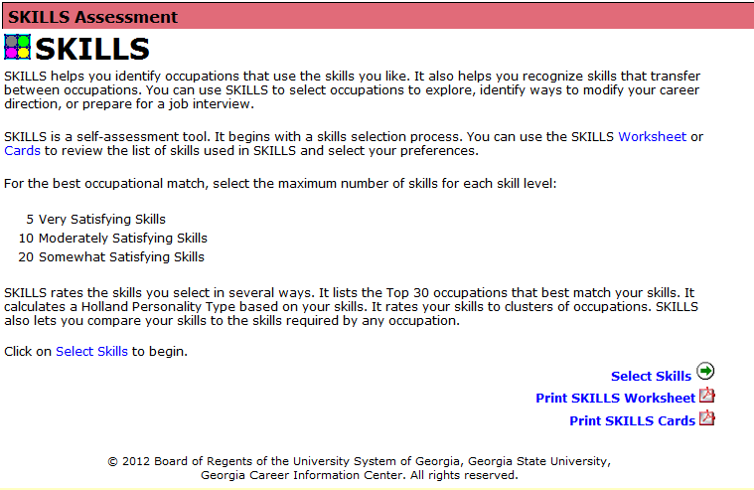
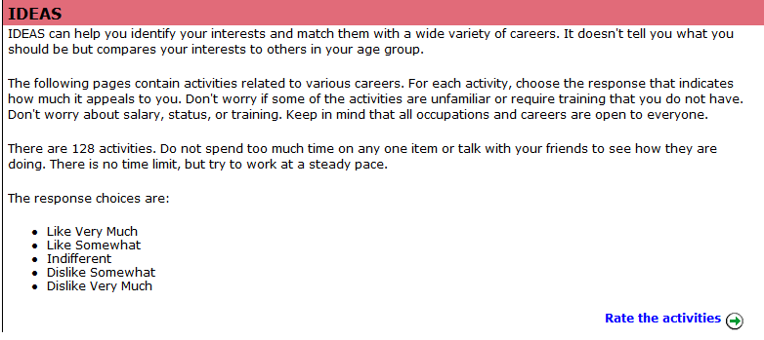
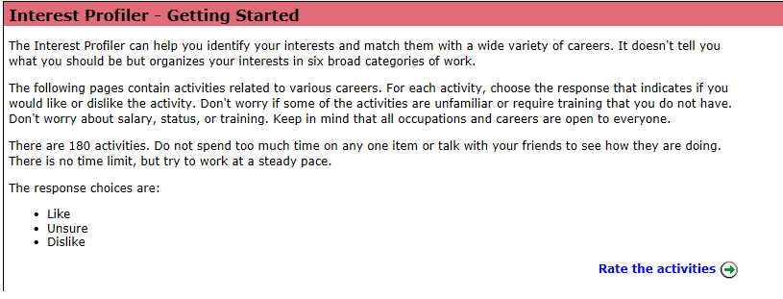
Career Assessment Tools

Slide 16
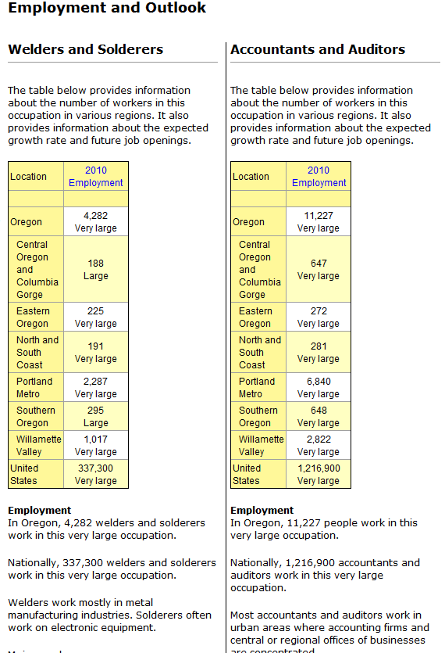
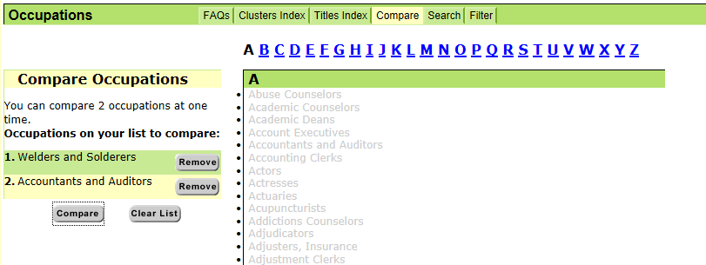
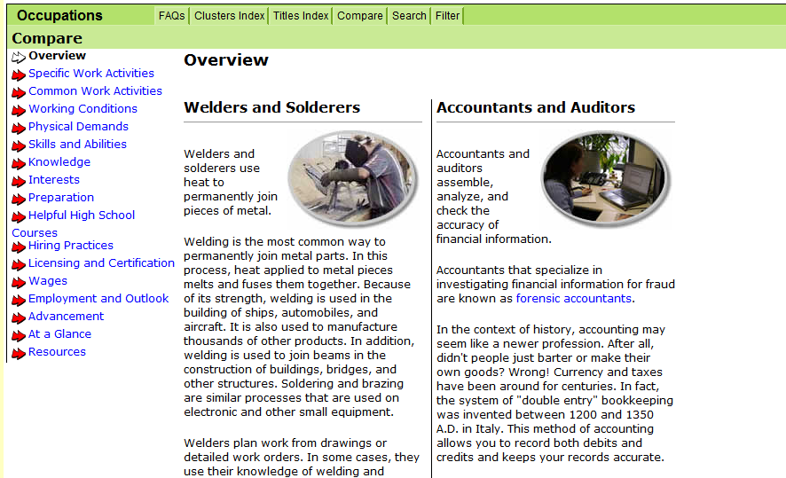
Career Exploration

Slide 17
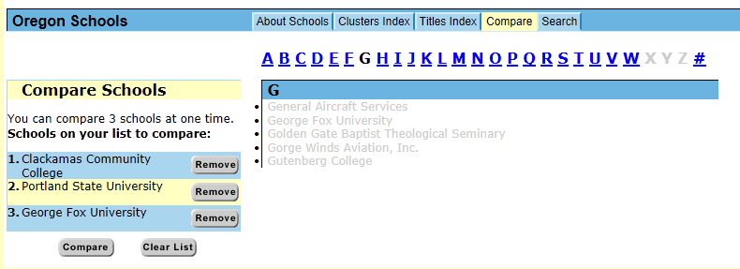
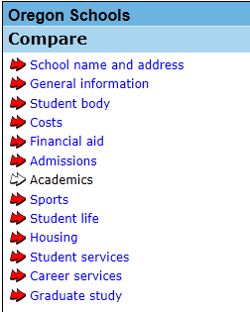
Compare Schools

Slide 18
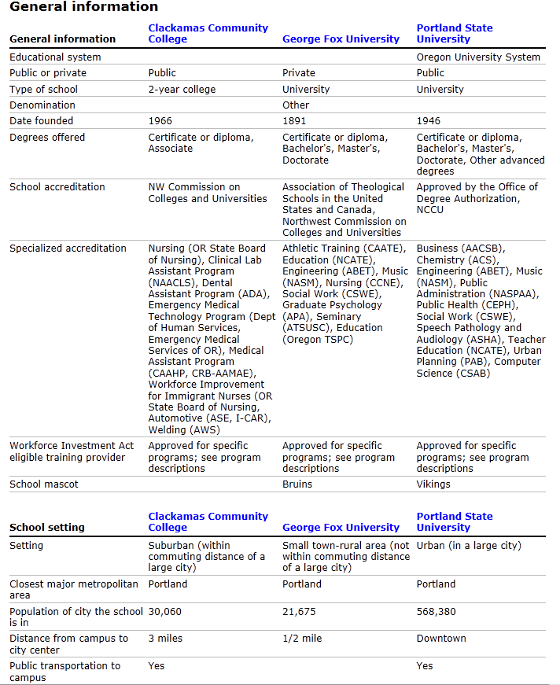
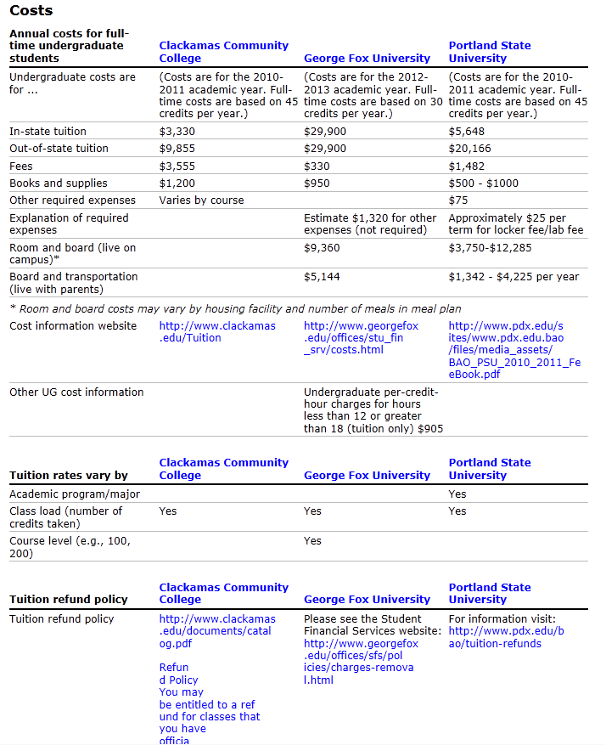
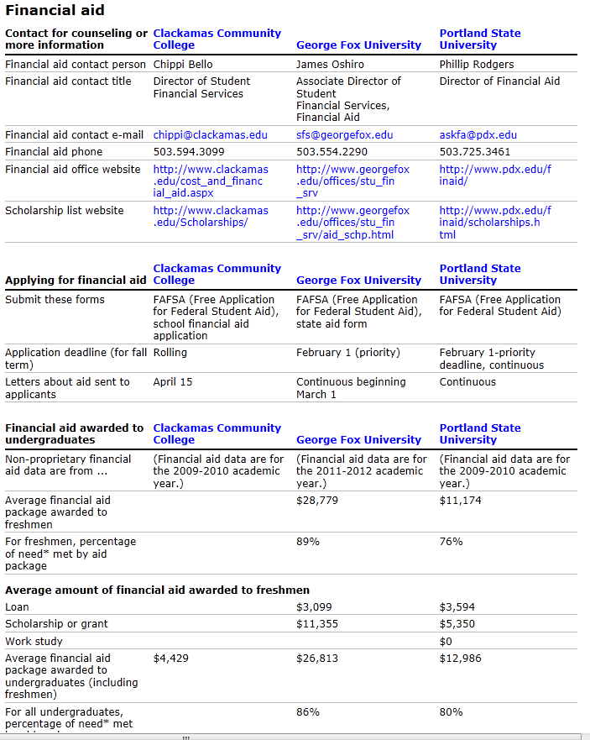
Comparing Colleges Using CIS

Slide 19
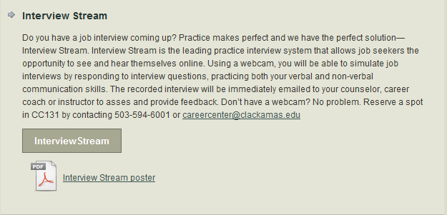
Interview Stream

Slide 20
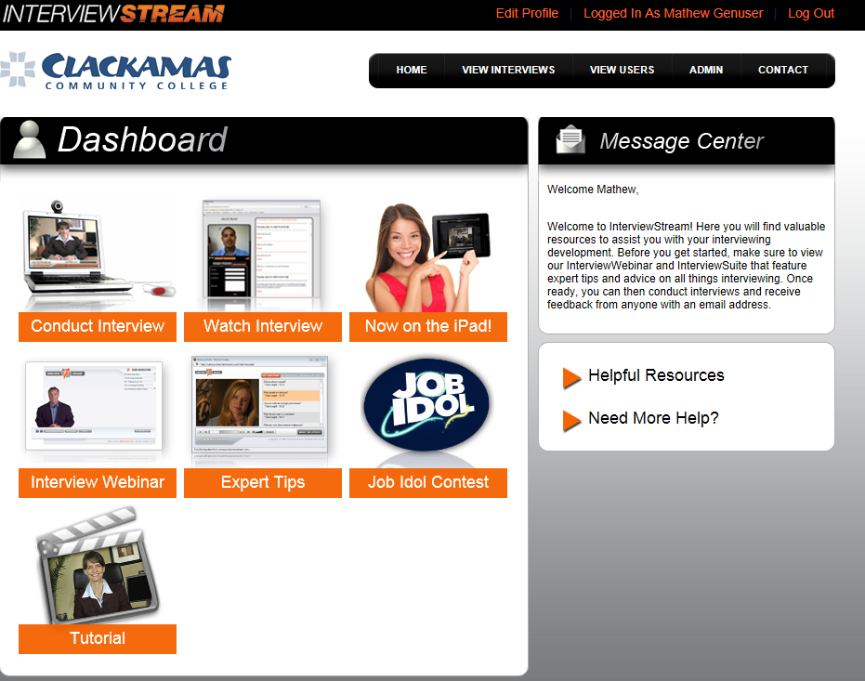
Interview Stream

Slide 21
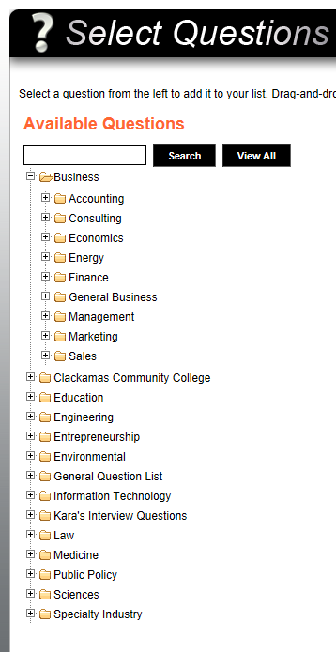
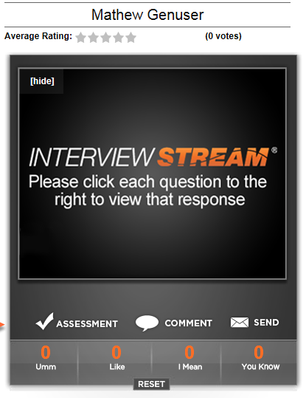
Create & Critique

Slide 22
Resumes, Cover Letters, Job Search Strategies

Slide 23
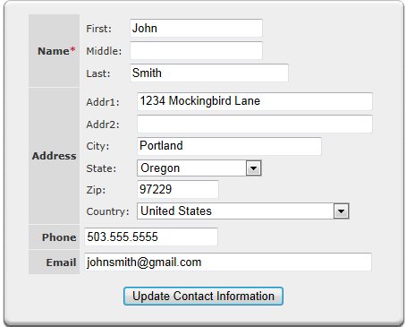
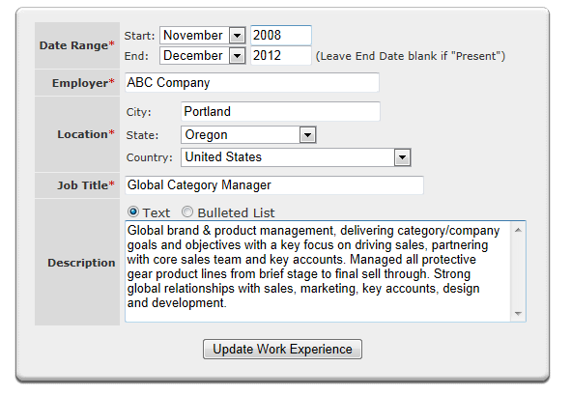
Resume Builder
“All you have to do is fill in the blanks.”

Slide 24
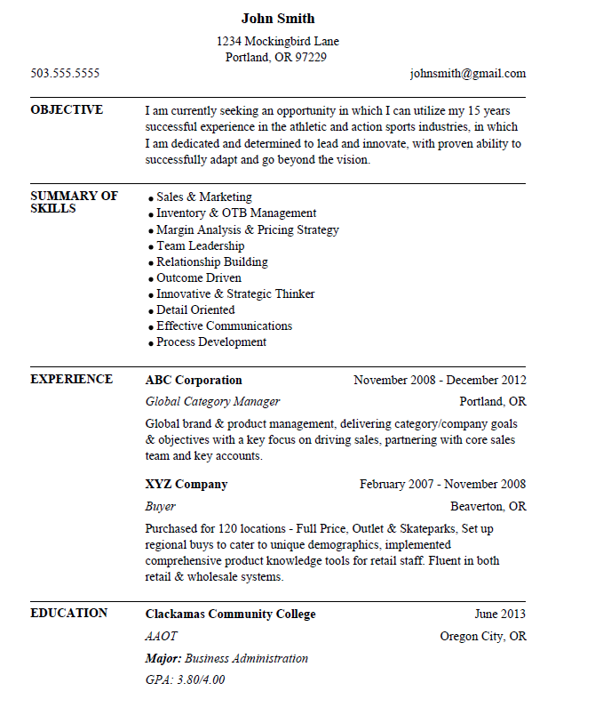
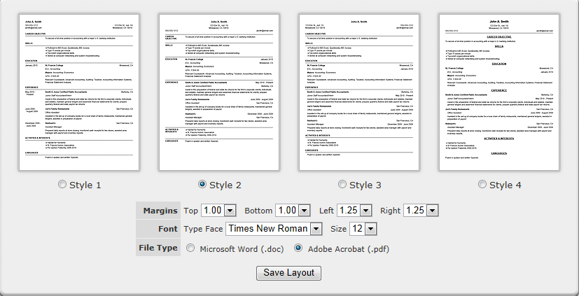
Resume Builder Sample
4 templates to choose from & totally customizable

Slide 25
3 Step Prep

Slide 26
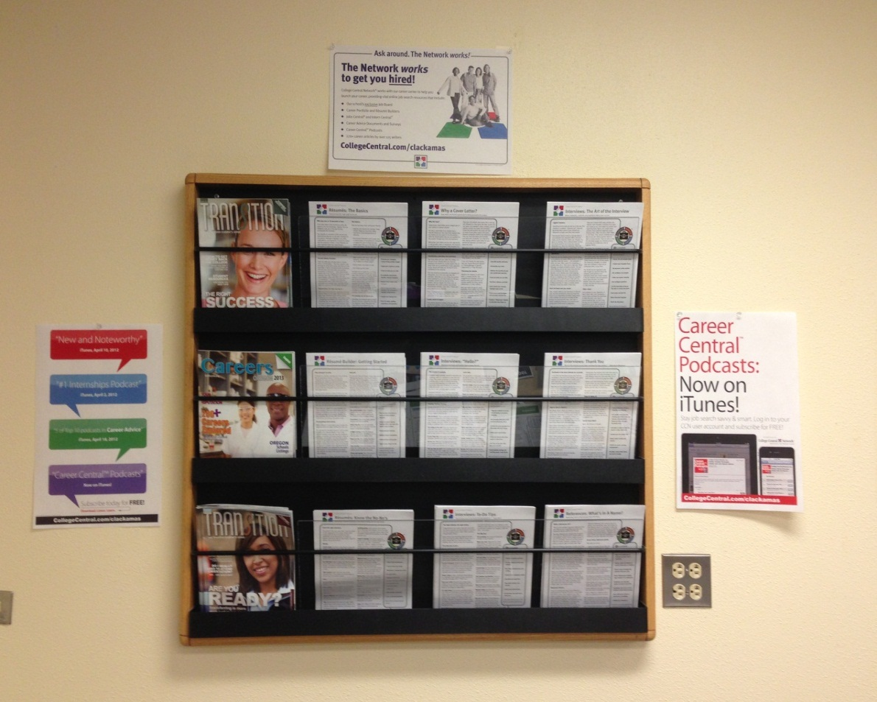
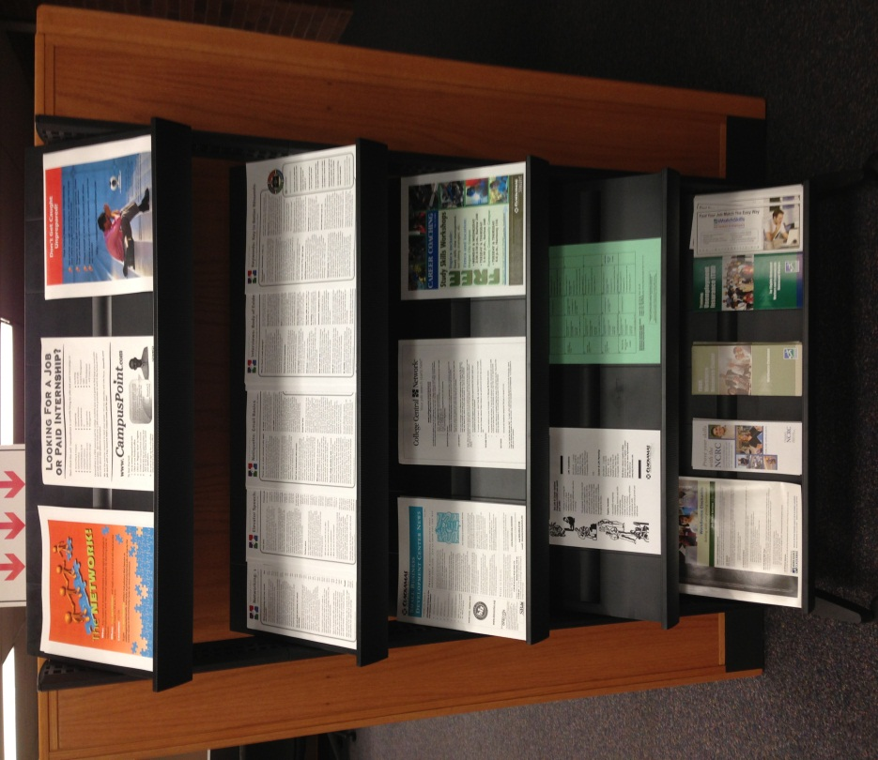
Community Partners & Additional Resources

